Slide 1
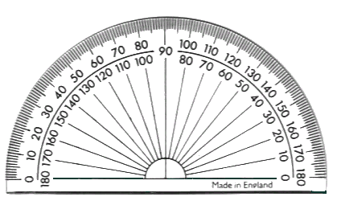
A 180º Protractor
Outside scale from 0º to 180º going in a clockwise direction.
Inside scale from 0º to 180º going in an anti-clockwise direction.

Slide 2
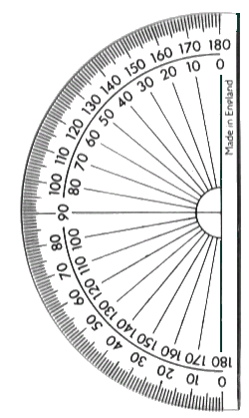
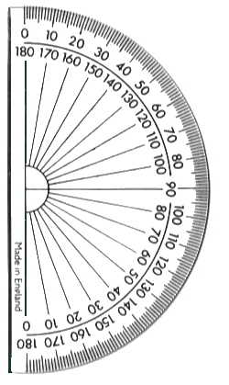
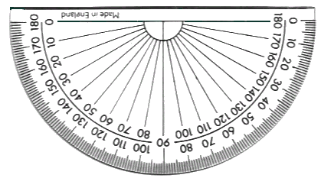
You need to be able to measure an angle to the nearest degree. To help you do this you should always:
1. Look directly down onto the cross point. (this avoids parallax errors)
2. Always use the protractor in a horizontal manner as shown below.
✓

Slide 3
Measuring Angles with a 180º Protractor
1
50º
2
0 on the inside so use inside scale
67º
0 on the outside so use outside scale

Slide 4
Measuring Angles with a 180º Protractor
3
120º
4
135º
0 on the inside so use inside scale
0 on the outside so use outside scale

Slide 5
Measure each angle in the shapes below.
1
90⁰
2
3
67⁰
67⁰
68⁰
90⁰
90⁰
112⁰
68⁰
90⁰
112⁰
46⁰
Rectangle 360⁰
Trapezium 360⁰
Triangle 180⁰
4
5
48⁰
6
118⁰
107⁰
73⁰
90⁰
101⁰
101⁰
42⁰
110⁰
110⁰
73⁰
107⁰
Parallelogram 360⁰
Triangle 180⁰
Pentagon 540⁰

Slide 6
Estimating Angles
1
2
3
4
5
6

Slide 7
1
2

Slide 8
3
4

Slide 9
Measure each angle in the shapes below.
1
2
3
4
5
6

